Slide 1

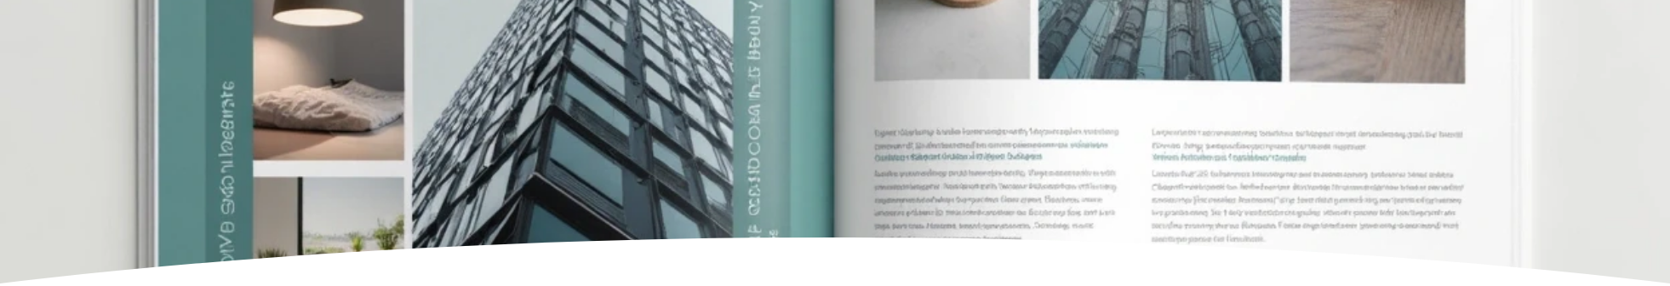
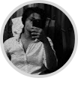
Portfolio Presentation
Author: Inu Mukil
Created with Pi

Slide 2

CONTENTS
1. Introduction
2. About
3. Projects
4. Blog
5. Skills
6. Testimonials
7. Contact
8. Footer

Slide 3

01
Introduction

Slide 4

Overview
Hi — I'm inumukiliniyan. I build web experiences and small apps. I enjoy clean UI, readable code, and fast performance.

Slide 5

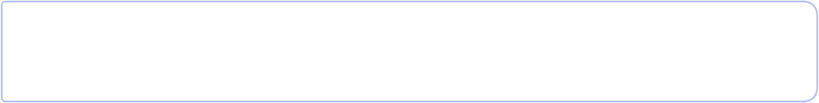
Call to Action
Hire me
Contact

Slide 6

02
About

Slide 7

Background Information
I'm a frontend developer who focuses on accessible, responsive interfaces. I work with HTML, CSS, JavaScript — and enjoy learning new tools.

Slide 8

Experience
Built 10+ websites and small apps for clients and personal projects.
Familiar with Git, responsive design, and performance optimisation.

Slide 9

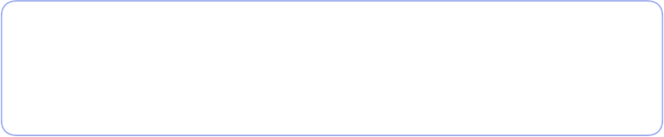


Education
1
2
B.Sc. in Computer Science – Example University (2020–2023)
Certifications in Frontend Development and UI/UX Design

Slide 10

03
Projects

Slide 11

Project List
Portfolio Website
A responsive single-page portfolio (this project).
Task Manager App
A tiny JS app for tracking tasks with local storage.
Weather App
A small weather dashboard using OpenWeatherMap API and fetch.

Slide 12

04
Blog

Slide 13

Recent Articles
Why I Love Minimal UI
Exploring the power of simplicity in interface design and how it improves usability.
Top Tools I Use in Frontend Dev
A quick dive into my preferred dev tools, including VS Code, Figma, and GitHub.

Slide 14
05
Skills

Slide 15



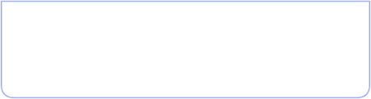
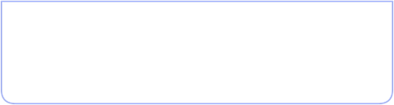
Skill Set
1
2
3
HTML
CSS
JavaScript
4
5
Responsive Design
Git

Slide 16
06
Testimonials

Slide 17





Testimonials
1
“Inumukiliniyan delivered exactly what we needed — fast, clean, and responsive.”\
— Client A
2
“Highly recommended for any frontend work. Reliable and creative.”\
— Client B

Slide 18

07
Contact

Slide 19

Contact Form
Fill out the form to get in touch.

Slide 20

Contact Form
Email
Or email: inumukiliniyan@example.com

Slide 21

08
Footer

Slide 22

Footer
©️ inumukiliniyan — Built with HTML & CSS
GitHub
LinkedIn
Email

